Slide 1
Analyzing Amazon Sales Data

Slide 2
Introduction
Amazon one of the largest e-commerce platforms globally, Amazon's vast product range, customer base, and data volume make it a goldmine for business insights.
In this project will explore key sales trends, identify top-performing product categories, evaluate seasonal patterns, and uncover customer behavior that drives revenue. Our goal is to turn raw data into actionable strategies that can enhance decision-making and boost sales performance.
Sales management has gained importance to meet increasing competition and the need for improved methods of distribution to reduce cost and to increase profits. Sales management today is the most important function in a commercial and business enterprise.

Slide 3
Objectives
The primary objectives of this project are:
To clean, extract and transform data set.
To analyse trends and key performance.
To find sales in time period like Month, year and yearly month.
To analyse total sales and total profit

Slide 4
Data Collection & Processing
Dataset Description:
Source: Amazon Sales Data
Time Period: 2010 - 2017

Slide 5
Data Cleaning & Transformation (Python)
1. Removed Unnecessary Columns and rename
2. Extract order month, order year, and order monthly year from order date Column
3. Handled Missing Values
4. Changed Data Types

Slide 6
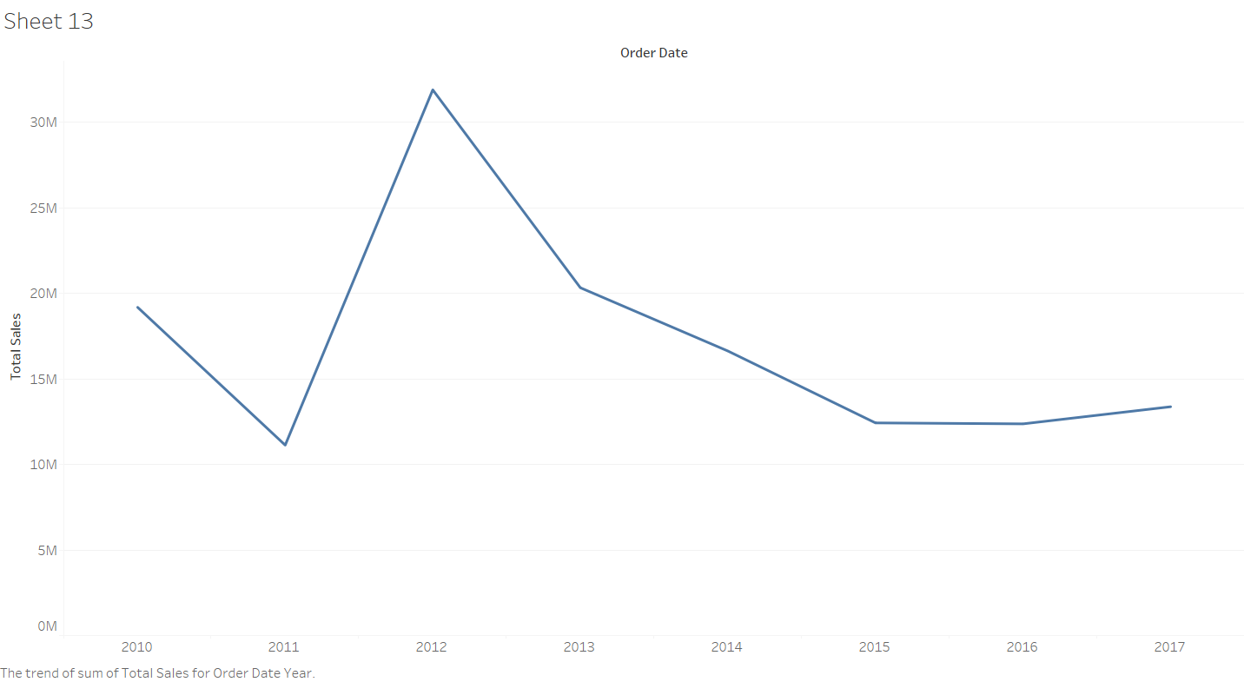
Dashboard and Visualization
1. Total sales trend (Line Chart)
Purpose: show changes in total sales from 2010 - 2017
Findings:
Sales dropped from around 19M in 2010 to just above 10M in 2011.
Increase in sales to over 30M in 2012, the highest point on the chart.
After the 2012 peak, sales consistently decreased over the next three years.
From 2015 to 2016, sales remained nearly flat.

Slide 7
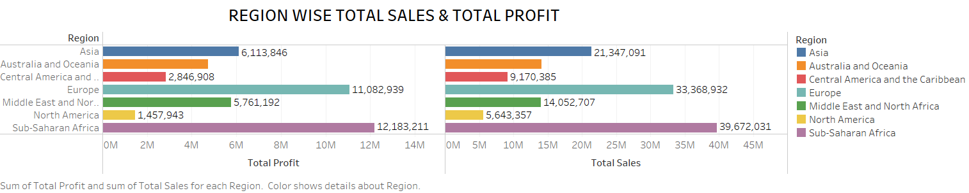
2. Region wise total sales and total profit
Findings:
This bar chart represents Total sales & Total profit across different regions.
Highest Sales & Profit Region: Sub-Saharan Africa, Total Sales 39.67M (Highest among all regions),Total Profit 12.18M (Also the highest) This region leads in both revenue generation and profitability, indicating a strong business presence and effective cost management.
Lowest Sales & Profit Region: North America, Total Sales: 5.64M and Total Profit: 1.46M. both sales and profit are the lowest; might require investigation into market penetration, pricing strategy, or operational inefficiencies.

Slide 8
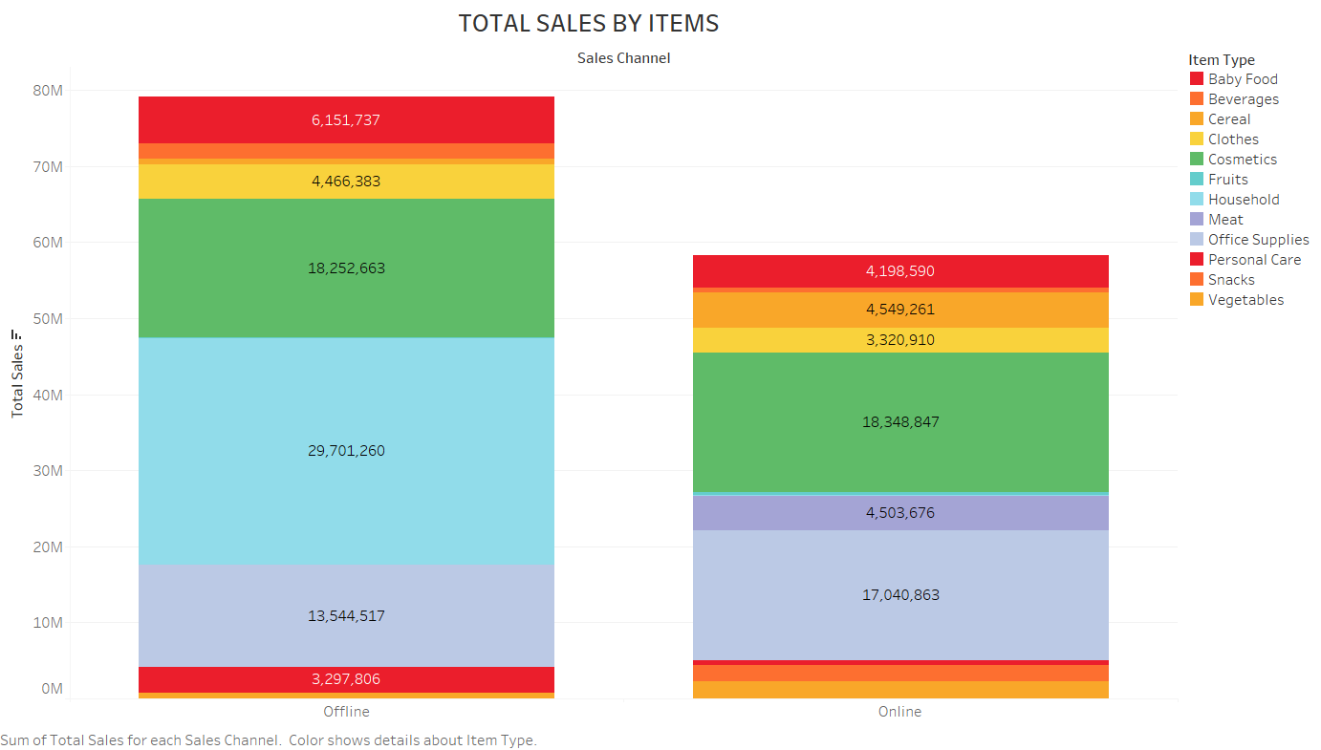
3. Top sales items by online & offline
Findings:
Offline Sales Total: Significantly higher, with major contributions from multiple product categories.
Online Sales Total: Lower in overall volume, but certain categories perform very strongly.
Top Performing item by Channel: Online cosmetics & Offline household.
Cosmetics are popular on both channels.
Household goods are majority sold offline (29.7M) with almost no online presence.

Slide 9
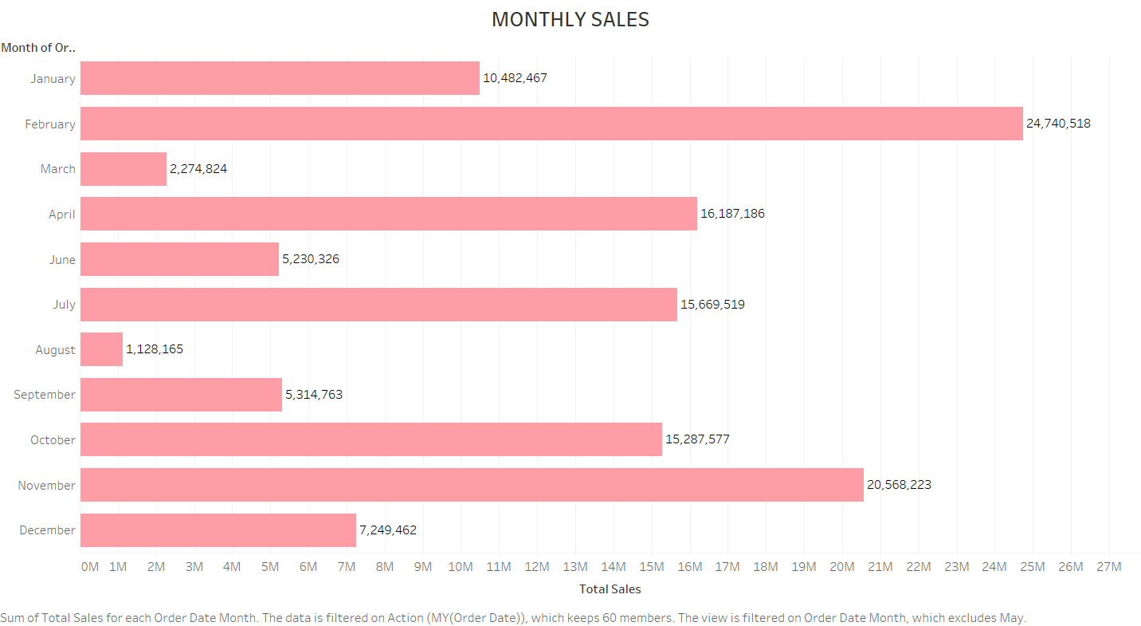
4. Monthly Wise Sales
Findings:
This bar chart represents Total sales across different months.
Top Performing Month: February Sales 24,740,518. Highest sales across all months, significantly ahead of others.
Strong Sales Months are November 20,568,223, July 15,669,519, April 16,187,186 and October 15,287,577.
These months consistently perform well, possibly due to seasonal promotions, product launches, or market trends.
Lowest Sales Month: March and August.

Slide 10
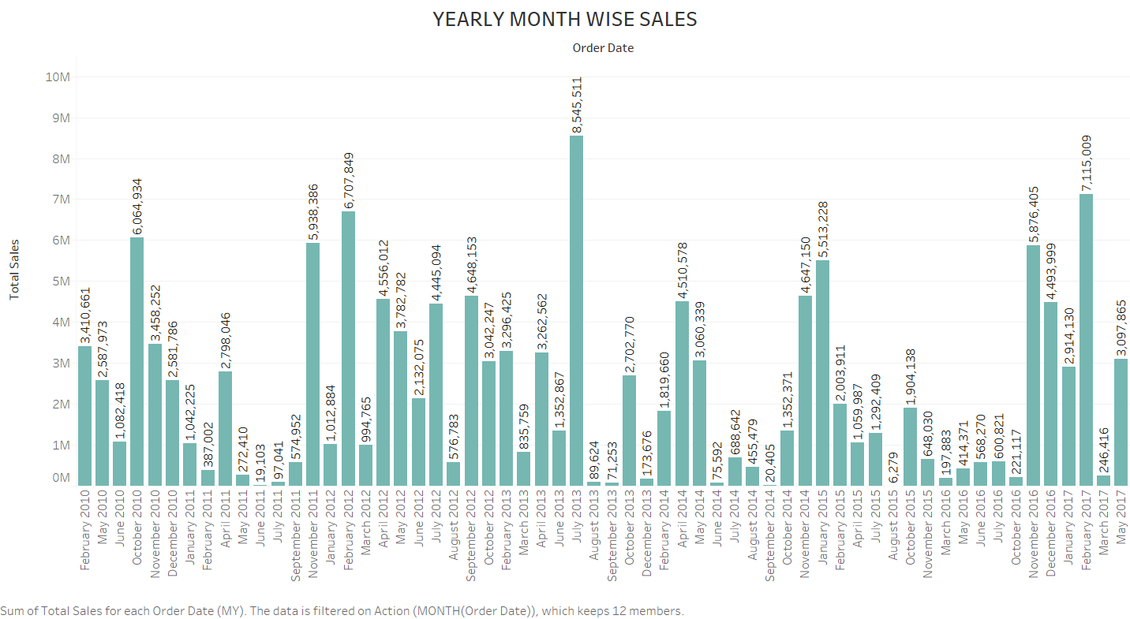
5. Yearly Month Wise Sales
Findings:
Top Peak Month-Year is July 2013 – 8,545,511,The highest monthly sales spike across all years.
These are major sales highs March 2017 – 7,115,009, October 2010 – 6,064,394, February 2012 – 6,707,849, November 2012 – 5,938,386.
September 2014 – 20,405 is Very low performance.
2012 and 2013 were high-performing years across multiple months.
2016 consistently shows lower monthly sales it indicates market downturn.

Slide 11
Suggestions
The amazon sales analysis time period on 2010 to 2017. The total sales in 2010 is around 19M and gradually increases in the years .at last the amazon sales value in 2012 around 31M.This amazon sales increase but next years decreased.
Analyze marketing campaigns, product launches, or discount strategies that led to spikes.
Evaluate August, April, and September 2014 – understand the reason for dips.
Sales in 2016 are consistently low – consider if there were Market issue or product issue. A notable decline in 2016 suggests operational, market, or competitive issues that need further investigation.
To study about North America region market and consumers. Why sales decrease?. To require investigation into market penetration, pricing strategy, or operational inefficiencies.

Slide 12
Conclusion
This analysis emphasizes the importance of recognizing and capitalizing on peak performance periods, investigating underperformance trends, and leveraging data-driven strategies to ensure consistent and increasing growth.
2012 emerged as the most successful sales year with 31.9M, showcasing Amazon's peak performance in the analyzed period. February was the best-performing month.

